Slide 1

AMAZON REVIEW SENTIMENT ANALYSIS
Using NLP

Slide 2
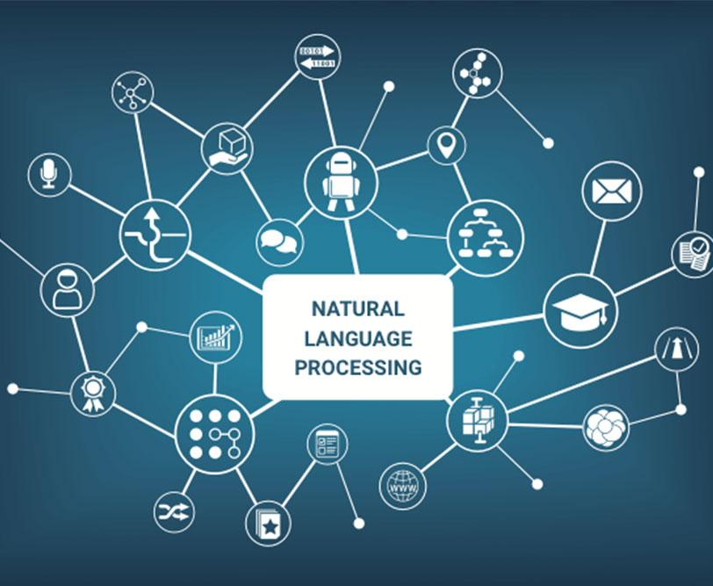
Natural Language Processing (NLP)
It is a subfield of linguistics, computer science, and artificial intelligence concerned with the interactions between computers and human language, how to program computers to process and analyze large amounts of natural language data. The result is a computer capable of understanding the contents of documents, including the contextual nuances of the language within them. The technology can then accurately extract information and insights contained in the documents as well as categorize and organize the documents themselves.

Slide 3
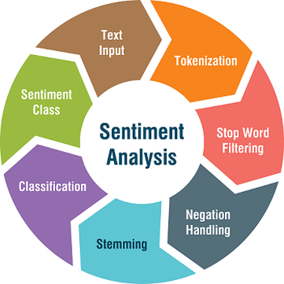
Sentiment Analysis
It is the process of classifying whether a block of text is positive, negative, or neutral. Sentiment analysis is contextual mining of words which indicates the social sentiment of a brand and helps the business to determine whether the product which they are manufacturing is going to make a demand in the market or not. The goal which Sentiment analysis tries to gain is to analyze people’s opinion in a way that it can help the businesses expand. It focuses not only on polarity (positive, negative & neutral) but also on emotions (happy, sad, angry, etc.).

Slide 4
A brief about Dataset used
The dataset contains Amazon's Alexa product reviews.
It has 5 columns: Rating, Date, Variation, Verified Reviews and Feedback i.e., 1 for Positive and 0 for Negative.
Reviews are text data and Ratings are numbering from 1 to 5 where 1 is the worst and 5 is the best review.
There is total 3150 reviews i.e., data instances.
The dataset we used here resembles a real business dataset.
Rating | Date | Variation | Verified Reviews | Feedback
5 | 31-Jul-18 | Charcoal Fabric | Love my Echo! | 1
5 | 31-Jul-18 | Charcoal Fabric | Loved it! | 1
4 | 31-Jul-18 | Walnut Finish | Sometimes while playing a game, you can answer... | 1
5 | 31-Jul-18 | Charcoal Fabric | I have had a lot of fun with this thing. My 4 ... | 1
5 | 31-Jul-18 | Charcoal Fabric | Music | 1
. . | . . | . . | . . | . .

Slide 5



Pre-processing the Dataset
Grouping or Classifying the data based on customer Feedback
Out of 3150 Reviews, there are 2893 Positive Feedbacks, i.e., Feedback = 1
The remaining 257 Reviews are Negative Feedbacks, i.e., Feedback = 0

Slide 6
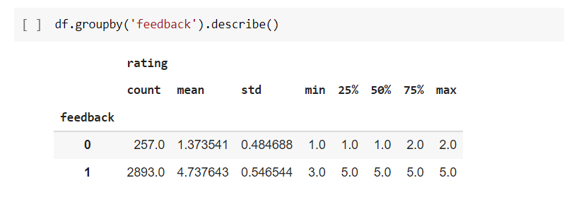

Slide 7

Pre-processing the Dataset
Modifying the Text Reviews before processing
Case Normalization: Convert the whole text into lower case
Lemmatization: Stemming of words and removing punctuation marks
Stopword Elimination: The words the, and, of, and on are considered stopwords in English so, they are removed.

Slide 8
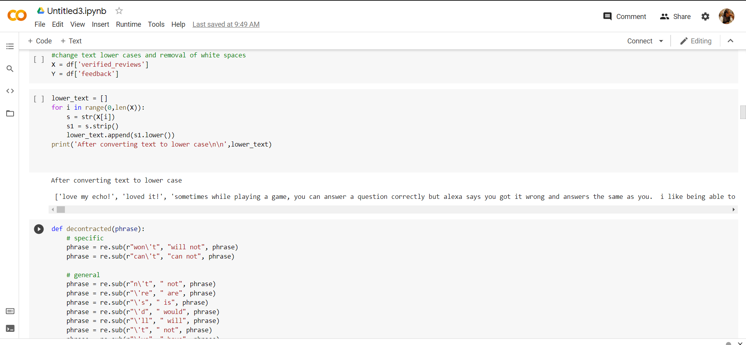

Slide 9
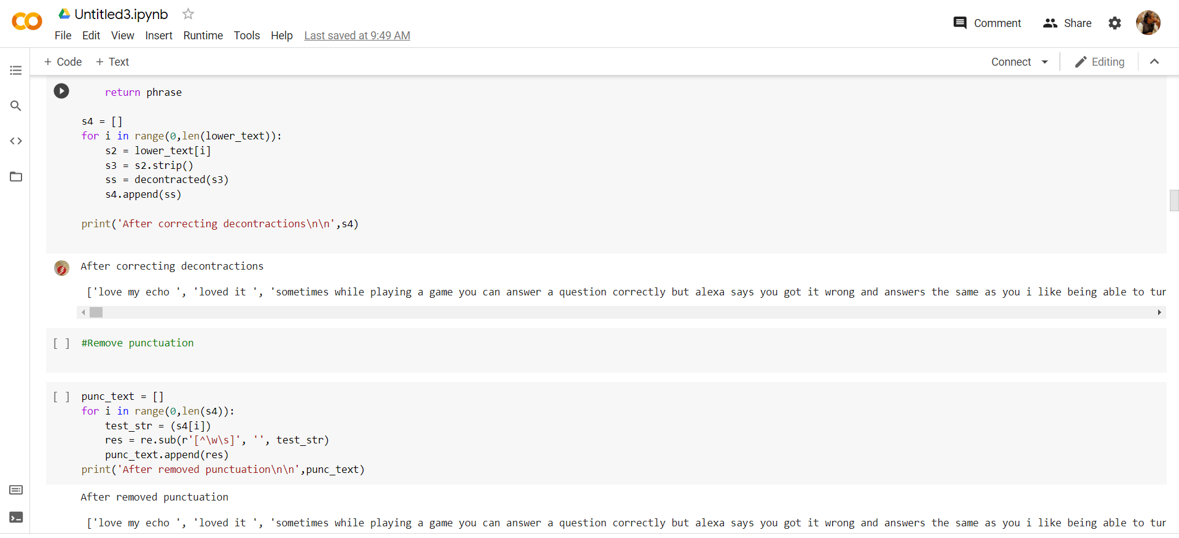

Slide 10

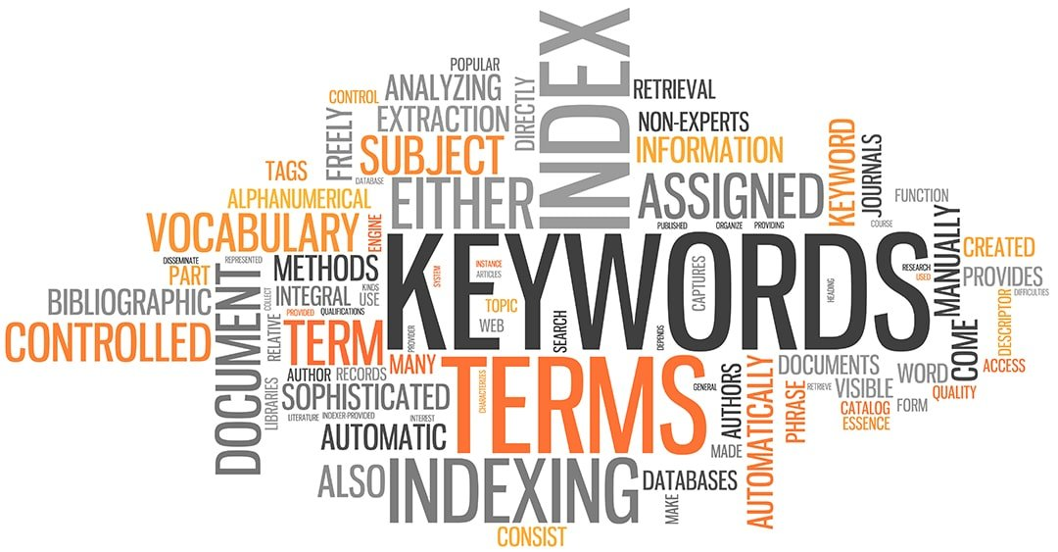
Word Vectorization
Converting words to vectors, or word vectorization, is a natural language processing (NLP) process. The process uses language models to map words into vector space.
A vector space represents each word by a vector of real numbers.
The de-facto standard way of doing this in the pre-deep learning era was to use a bag of words approach.
To improve this representation, you can use some more advanced techniques like removing stopwords, lemmatizing words, using TF-IDF.

Slide 11


Term Frequency-Inverse Document Frequency
(TF-IDF)
TF-IDF = TF(t,d) * IDF(t)

Slide 12
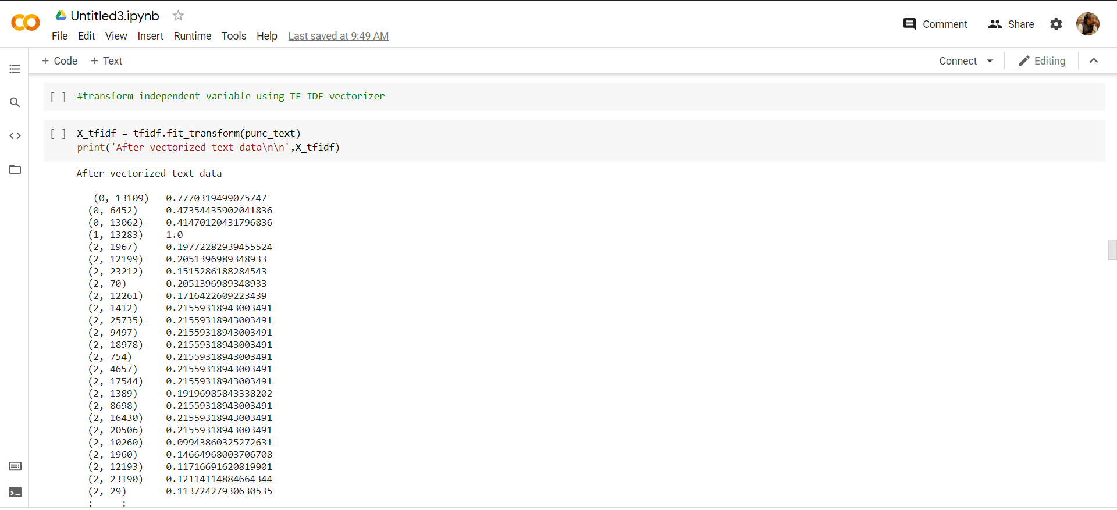

Slide 13

Processing the data
After Word Vectorization, we then move onto processing the data. Here, we first split the data into two categories i.e., Training Data and Test Data
Training Data:
The observations in the training set form the experience that the algorithm uses to learn. In supervised learning problems, each observation consists of an observed output variable and one or more observed input variables.
Test Data:
The test set is a set of observations used to evaluate the performance of the model using some performance metric. It is important that no observations from the training set are included in the test set.
Prepared Data
Training Data
Test Data
Model Learning
Model Validation
Machine Learning

Slide 14
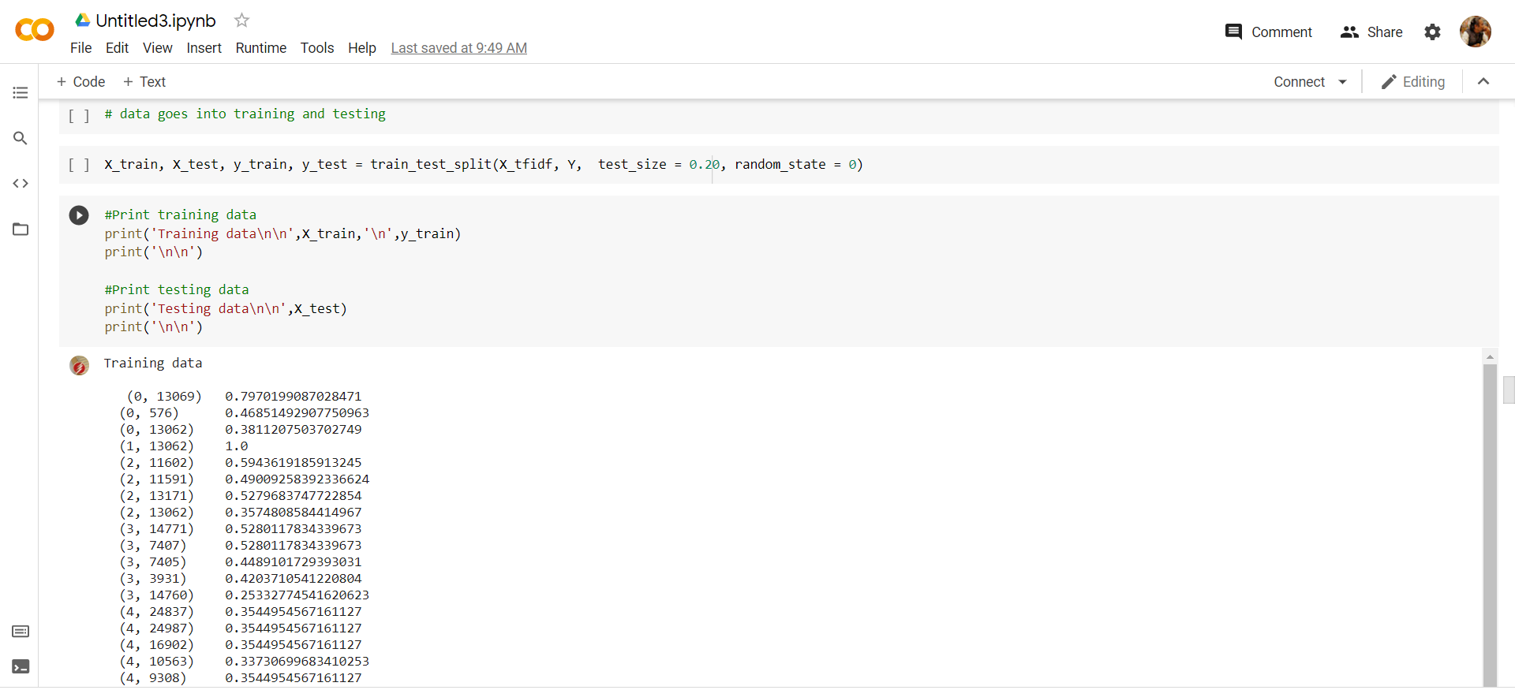

Slide 15
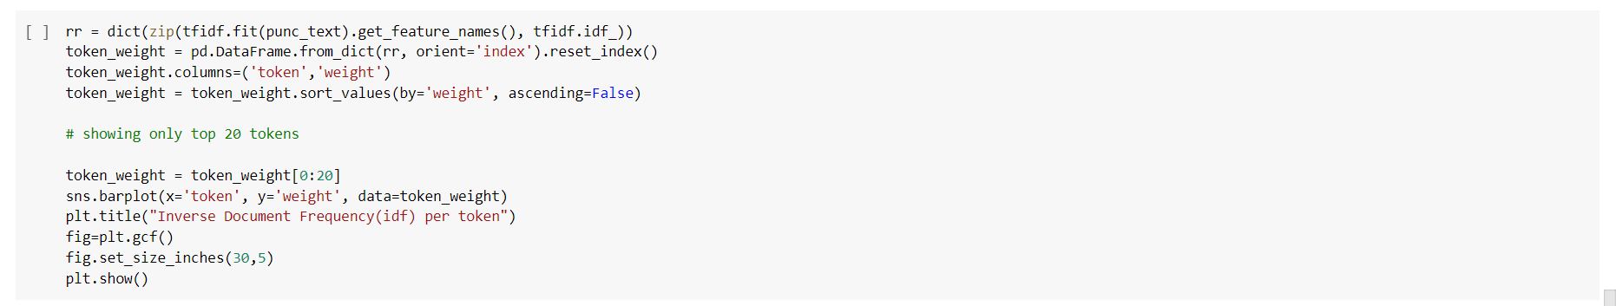
Token Frequency Distribution
A method for visualizing the frequency of tokens within and across corpus is frequency distribution. A frequency distribution tells us the frequency of each vocabulary item in the text. In general, it could count any kind of observable event. It is a distribution because it tells us how the total number of word tokens in the text are distributed across the vocabulary items.

Slide 16
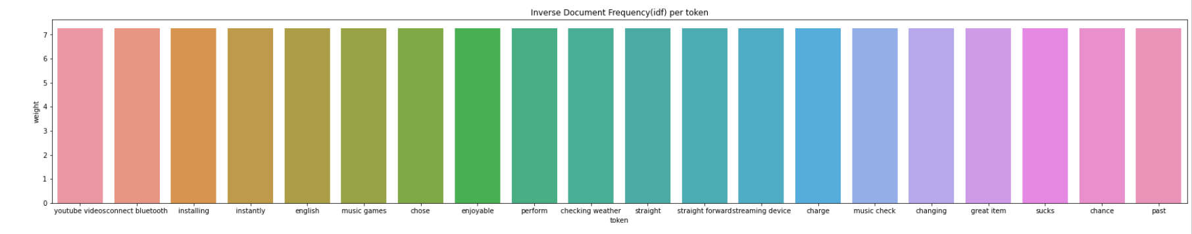

Slide 17

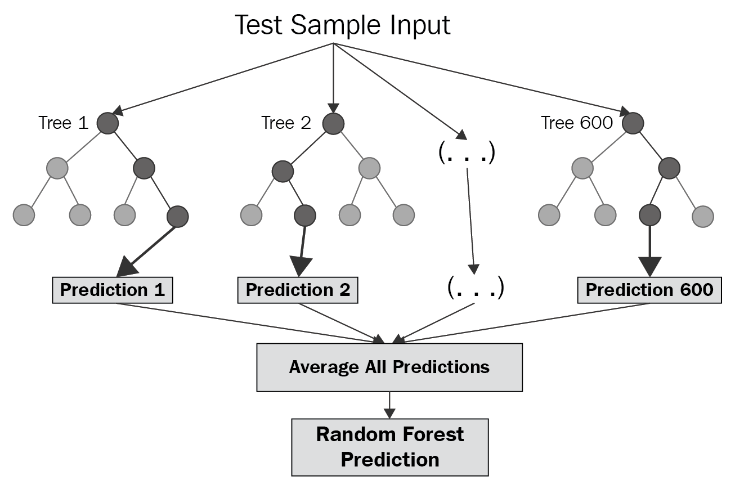
Random Forest Classifier
The Random forest or Random Decision Forest is a Supervised Machine Learning algorithm used for classification, regression, and other tasks using decision trees. The Random forest classifier creates a set of decision trees from a randomly selected subset of the training set.
The random forest algorithm works by completing the following steps:
Step 1: The algorithm select random samples from the dataset provided.
Step 2: The algorithm will create a decision tree for each sample selected. Then it will get a prediction result from each decision tree created.
Step 3: Voting will then be performed for every predicted result. For a classification problem, it will use mode, and for a regression problem, it will use mean.
Step 4: And finally, the algorithm will select the most voted prediction result as the final prediction.

Slide 18
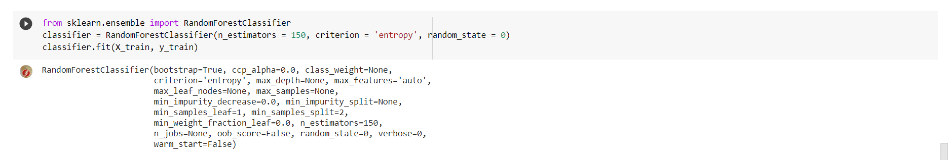

Slide 19

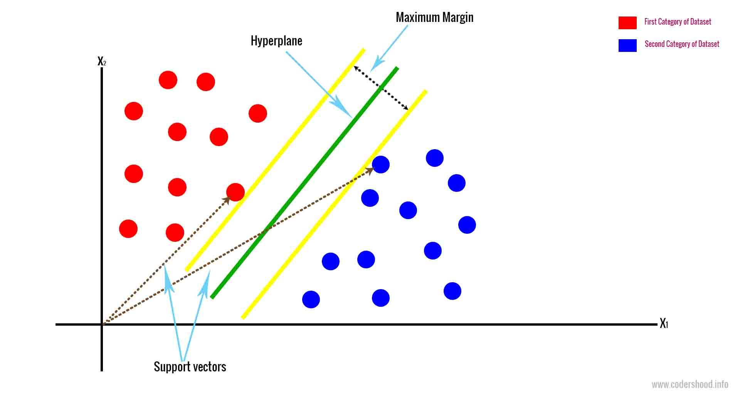
Support Vector Machines(SVM)
Support Vector Machine (SVM) is a simple Supervised Machine Learning Algorithm used for classification and/or regression. It is more preferred for classification but is sometimes very useful for regression as well. The goal of the SVM algorithm is to create the best line or decision boundary that can segregate n-dimensional space into classes so that we can easily put the new data point in the correct category in the future. This best decision boundary is called a hyperplane.

Slide 20
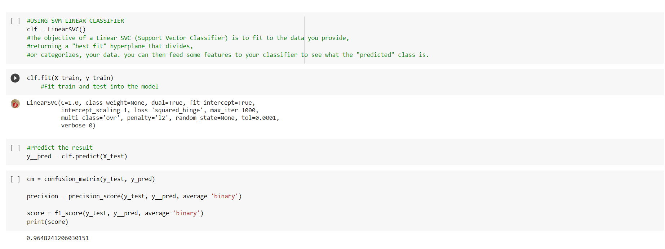

Slide 21
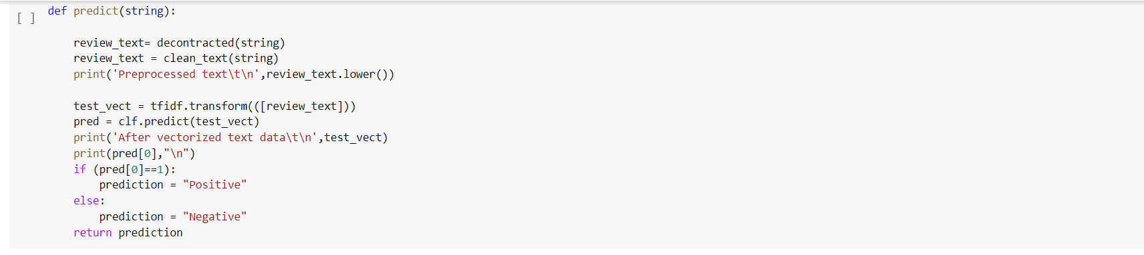

Slide 22

Conclusion:
Thus, using the above algorithms i.e., Random Forest Classifier and Linear SVM Classifier, we get an accuracy of the Test data with respect to the Training data around 95.0793 percent from both the algorithms.
Then, after all the preprocessing that includes Case Normalization, Lemmatization, Stopword Elimination, we use the TF-IDF vectorizer to get the significance of each term in the Reviews section, and then we split the data into Training and Test data along with the Feedbacks, thus getting to know the Positive or Negative significance of each term and then classifying it according to the Feedbacks.
To test our Classification Models, we use user defined Reviews to get the Feedback from the model as ‘Positive’ or ‘Negative’. Thus, we define a function ‘predict’ which predicts the feedback as per our review, First we preprocess the user defined review and calculate its TF-IDF frequency and then test it against our classification model to get the Feedback.

Slide 23

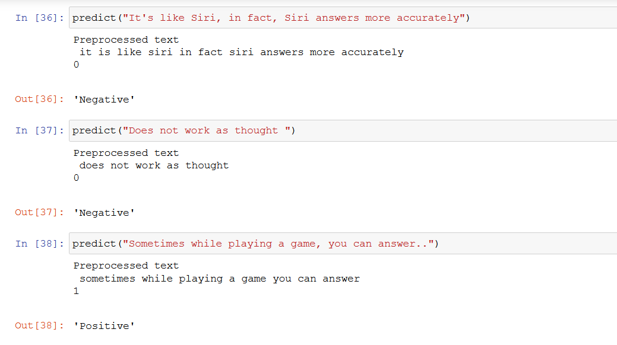
Working of predict function:

Slide 24
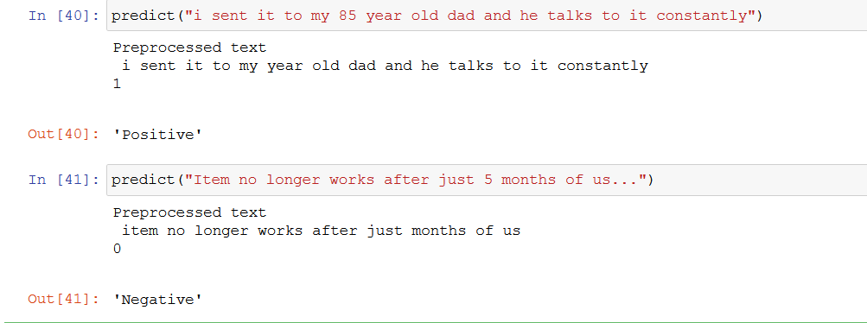
Working of predict function:

Slide 25

THANK YOU

